Slide 1
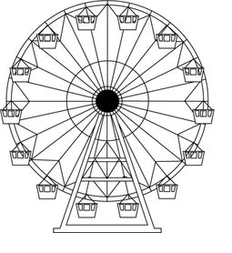
CIRCULAR MOTION
VERTICAL PLANE

Slide 2
FORCES
In understanding the forces at play during vertical circular motion, it makes sense to start with the resultant force (i.e. the centripetal force), then try to work out the vector sum. This is because we already know where the resultant force is pointing (i.e. to the centre of the circle).
The point of this is actually to find an expression for the reaction force (what this reaction force really is isn’t really important; it could be tension, or normal force – we will simply call it normal force here for the sake of simplicity).

Slide 3









FORCES
Top
$$F_{C}=F_{N}+F_{W}$$
Side
F_{W}
$$F_{N}=F_{C}−F_{W}$$
$$F_{C}=\frac{mv^{2}}{r}$$
F_{C}
$$F_{N}=\frac{mv^{2}}{r}−mg$$
F_{N}
$$F_{N}=m(\frac{v^{2}}{r}−g)$$
F_{C}
*Note that the normal force at the bottom of the circle is a maximum, whereas the normal force at the top of the circle is a minimum.
Bottom
F_{C}
$$F_{C}=F_{N}−F_{W}$$
F_{W}
$$F_{N}=F_{C}+F_{W}$$
F_{N}
$$F_{N}=\frac{mv^{2}}{r}+mg$$
$$F_{N}=m(\frac{v^{2}}{r}+g)$$
F_{W}

Slide 4



WEIGHTLESSNESS
If we consider the equations for normal force at the top of the circle, a realisation occurs; it should be possible to find a speed at which the normal force is 0.
Why is this significant? Because the way that we experience weight is not through the weight force (which acts through us onto a surface), but through the reaction/normal force acting on us. When the reaction force is 0, we can experience weightlessness! Note that the condition for weightlessness to occur is that F_{W} = F_{C} (as this is the condition for F_{N} = 0).
$$F_{N}=m(\frac{v^{2}}{r}−g)$$
$$∴\frac{v^{2}}{r}−g=0$$
$$v=\sqrt{gr}$$

Slide 5


GOING TOO FAST?
Of course, we could always try to go faster than the speed required for weightlessness. What happens then? Well, it depends on the situation.
Weightlessness occurs when the normal force is 0. When this happens, we can see from the equation that the centripetal force is provided entirely by gravity.
When we try to go faster, there is simply no more force available to increase the centripetal acceleration.
$$0$$
$$F_{C}=F_{N}+F_{W}$$

Slide 6

GOING TOO FAST?
Therefore, the radius of the circle must increase (if it can, say, when going over a hill):
while at the same time, this is increasing…
and this cannot change…
$$F_{C}=\frac{mv^{2}}{r}$$
If this is maxed out…
Then this must increase, as F_{C} cannot increase any more.
The result?

Slide 8
TRAVELLING UPSIDE-DOWN?
If we are in a roller-coaster travelling upside-down, we have a safety issue to consider; namely, we need to ensure that we are travelling fast enough so as not to fall out of the ride. In fact, we should be travelling fast enough that the safety harnesses are not required to prevent falling (in fact, they’re there to prevent people moving around during the ride).
If the speed of the rollercoaster at the top of the loop is such that F_{W} > F_{C} , then gravity would take over and we would fall (likely toward a grisly demise) before we reach the top.

Slide 9
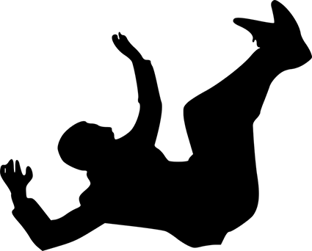
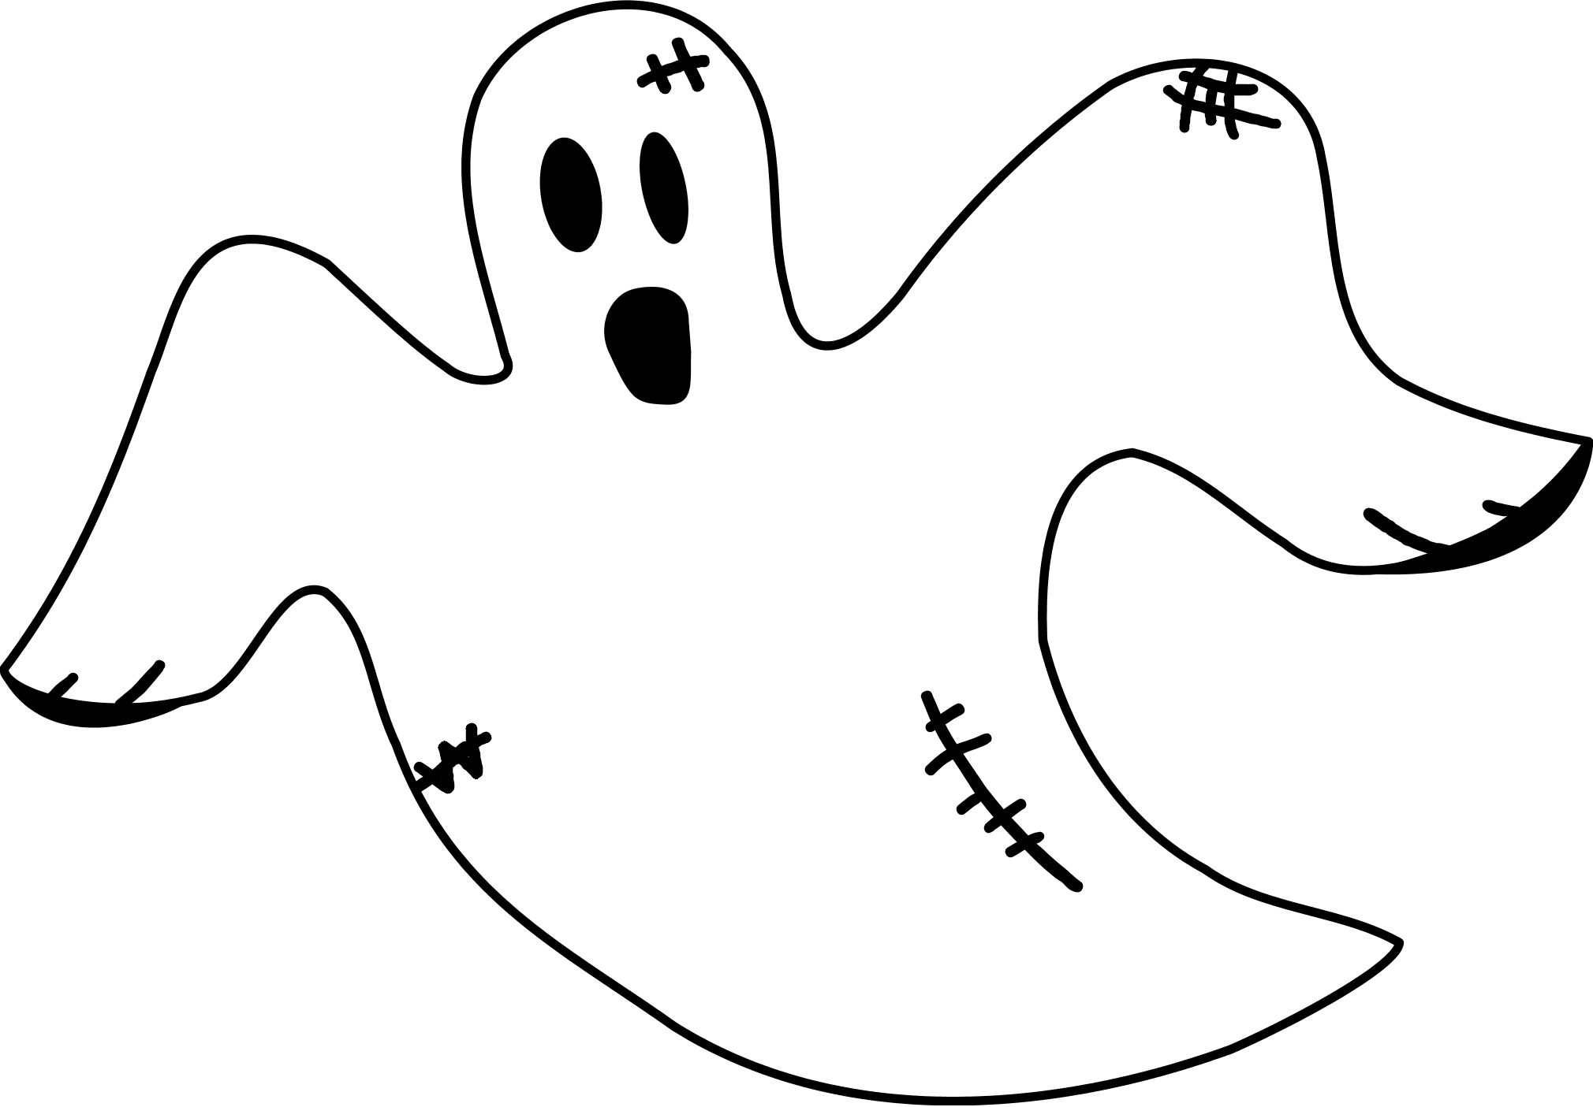
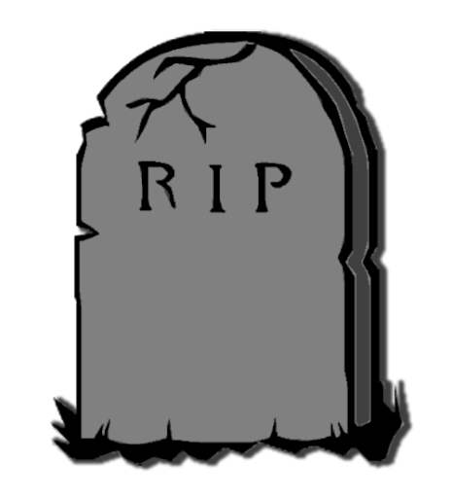
TRAVELLING UPSIDE-DOWN?
*With F_{W} > F_{C} , we are accelerating away from our roller-coaster cart faster than the cart is accelerating towards the centre of the circle. Therefore, we fall away from (i.e. out of) the cart…
F_{W}
F_{C}

Slide 10

TRAVELLING UPSIDE-DOWN?
To ensure that we achieve the minimum speed such that we don’t fall out, we need F_{W} = F_{C} , which just so happens to be the condition for weightlessness that we discussed earlier! Therefore, the minimum speed is:
If the speed of the rollercoaster at the top of the loop is such that F_{W} < F_{C} , then our seat will be accelerating towards the centre of the circle faster than we can fall due to gravity. Therefore, we don’t lose contact with the seat… i.e. we don’t fall out (and we don’t die – yay!).
$$v=\sqrt{gr}$$

Slide 11
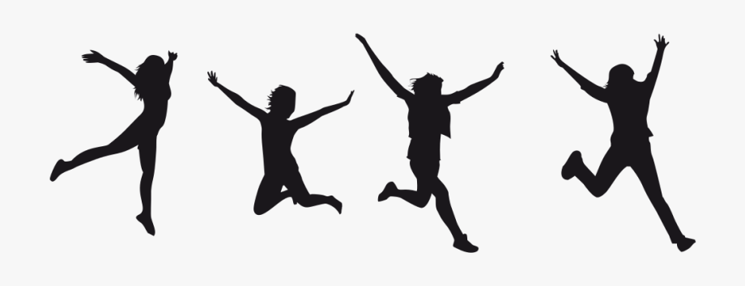
TRAVELLING UPSIDE-DOWN?
*If the speed of the rollercoaster at the top of the loop is such that F_{W} < F_{C} then our seat will be accelerating towards the centre of the circle faster than we can fall due to gravity. Therefore, we don’t lose contact with the seat… i.e. we don’t fall out (and we don’t die – yay!).
*In reality, this is a bit simplistic; the reason you don’t leave your chair is similar to the reason you get shoved into the car door when turning a corner, and takes inertia into account… but this is an aside.
3 Cheers for Not Dying!
F_{W}
F_{C}

Slide 12
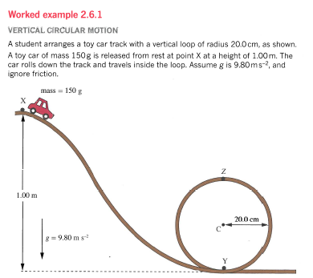
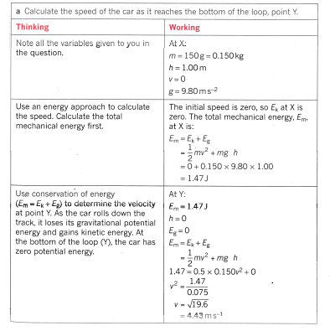
CONSERVATION OF ENERGY (Pearson p.81-83)

Slide 13
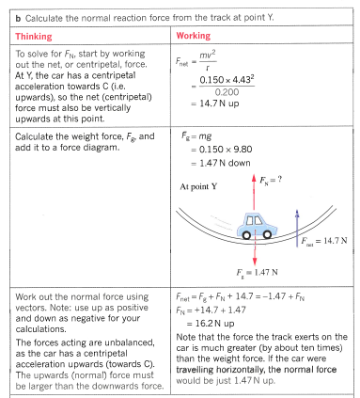
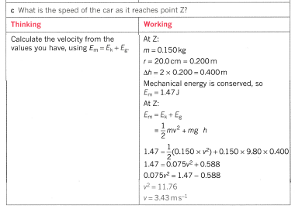

Slide 14
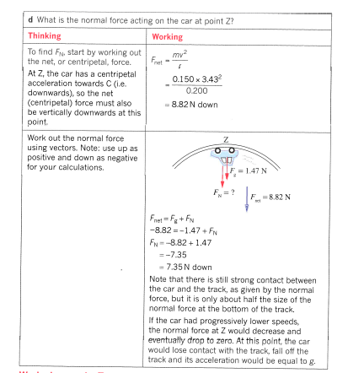

Slide 15
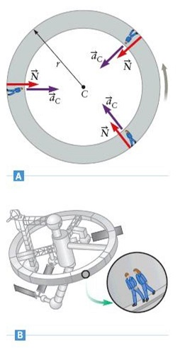
ARTIFICIAL GRAVITY
NASA exploit the principle of weightlessness at the top of a circular path to train astronauts for work in a weightless environment.
Circular Motion could also be used as a possible method to provide future space craft with a kind of artificial gravity, substituting centripetal force for gravitational force (just set the ship spinning and et voila!).

Slide 16
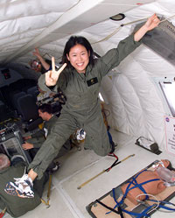
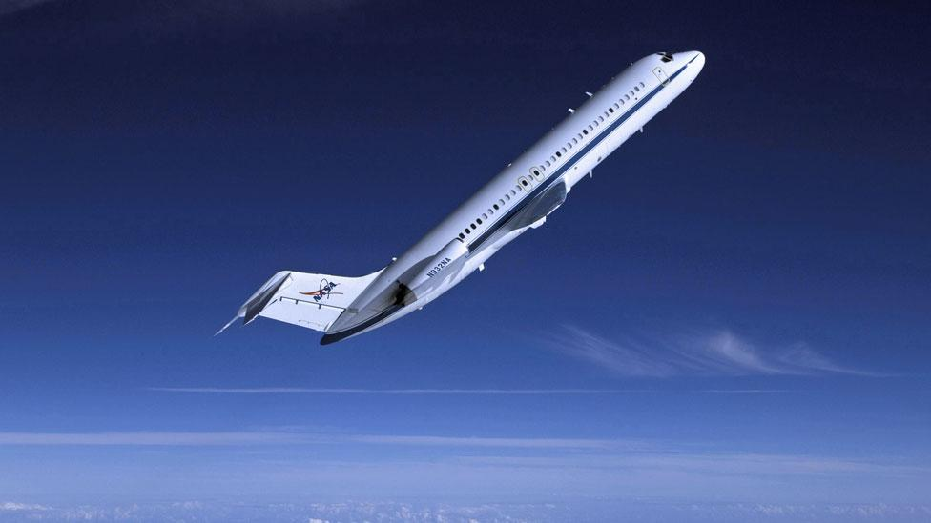
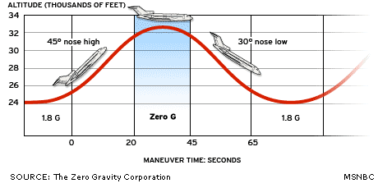
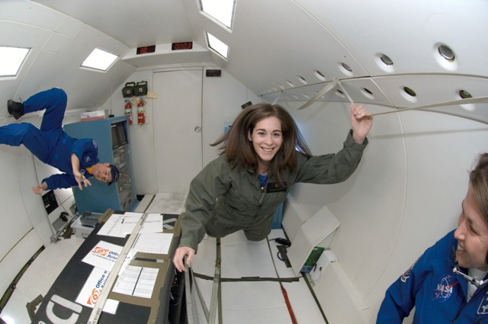
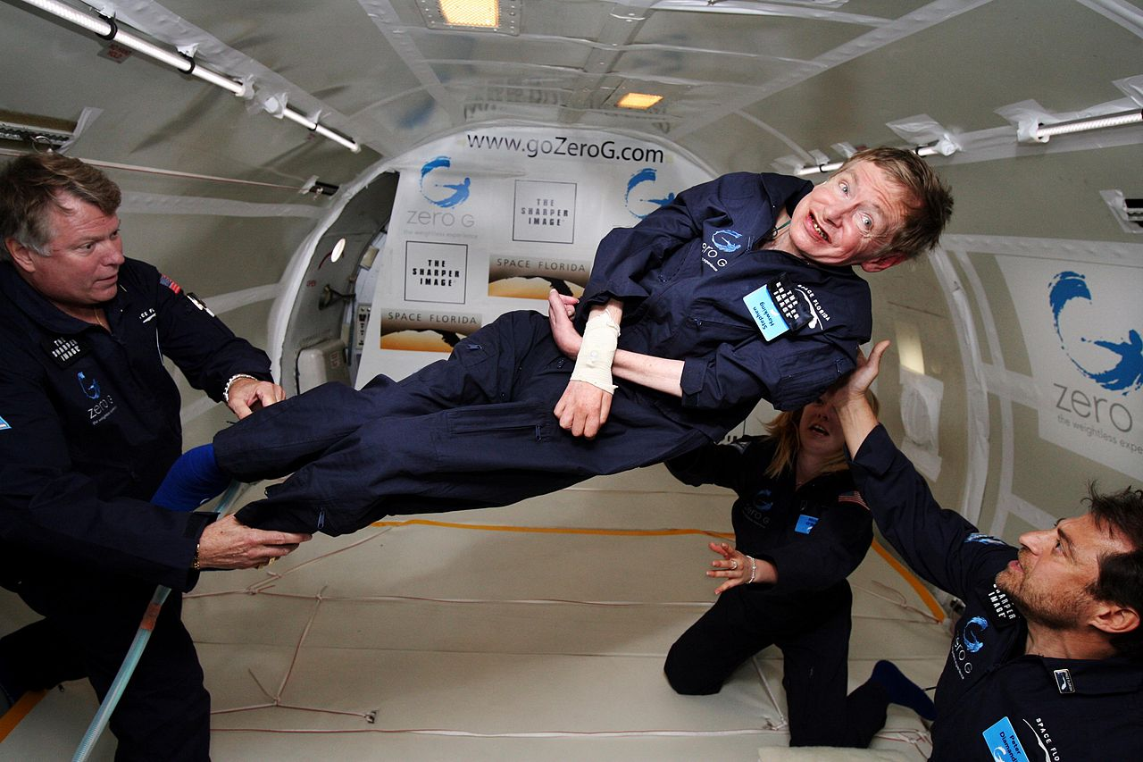
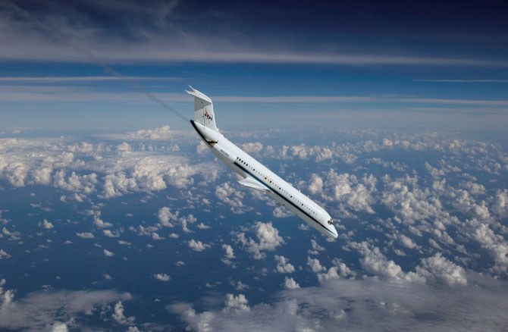
NASA’s “VOMIT COMET”

Slide 17
